Slide 1
Efficient Privacy-Preserving Approaches for Trajectory Datasets
IEEE International Conference on Cloud and Big Data Computing (CBDCom 2020)
Md Yeakub Hassan, Ullash Saha, Noman Mohammed, Stephane Durocher, Avery Miller
Department of Computer Science, University of Manitoba, Winnipeg, Manitoba

Slide 2










Transaction
Superstore₁ → Walmart₁ → Walmart₂ → Costco₁
Walmart₂ → Shoppers₁ → Superstore₂ → Costco₁
Costco₁ → Walmart₂ → Superstore₁
Customer | Transaction
Alice | Walmart₁ → Walmart₂
Bob | Walmart₂
Eve | Walmart₂
Tap&Pay
Customer | Transaction
Alice | Superstore₁ → Walmart₁ → Walmart₂ → Costco₁
Bob | Walmart₂ → Shoppers₁ → Superstore₂ → Costco₁
Eve | Costco₁ → Walmart₂ → Superstore₁

Slide 3

Problem Definition
Tap&Pay provides electronic money cards
Accumulate a large of amount of transnational data
Reveals trajectories with movement and behavioral patterns
Credit card companies publish this dataset
Discarding identity can breach individuals privacy
Adversary can identify customer trajectories using partial knowledge

Slide 4


ID | Trajectory
t₁^{A} | a₁
t₂^{A} | a₁
t₃^{A} | a₃→a₁
t₄^{A} | a₂
t₅^{A} | a₂
t₆^{A} | a₁
t₇^{A} | a₂
A
A
ID | Trajectory
t₁ | a₁→b₂→b₃
t₂ | b₁→a₁
t₃ | a₃→a₁→b₃
t₄ | b₂→b₁→a₂
t₅ | b₂→b₁→a₂
t₆ | b₂→b₁→a₁
t₇ | b₂→b₃→a₂
{a_{1,} a_{2,} a₃}
B
ID | Trajectory
t₁^{B} | b₂→b₃
t₂^{B} | b₁
t₃^{B} | b₃
t₄^{B} | b₂→b₁
t₅^{B} | b₂→b₁
t₆^{B} | b₂→b₁
t₇^{B} | b₂→b₃
{b_{1,} b_{2,} b₃}
B

Slide 5
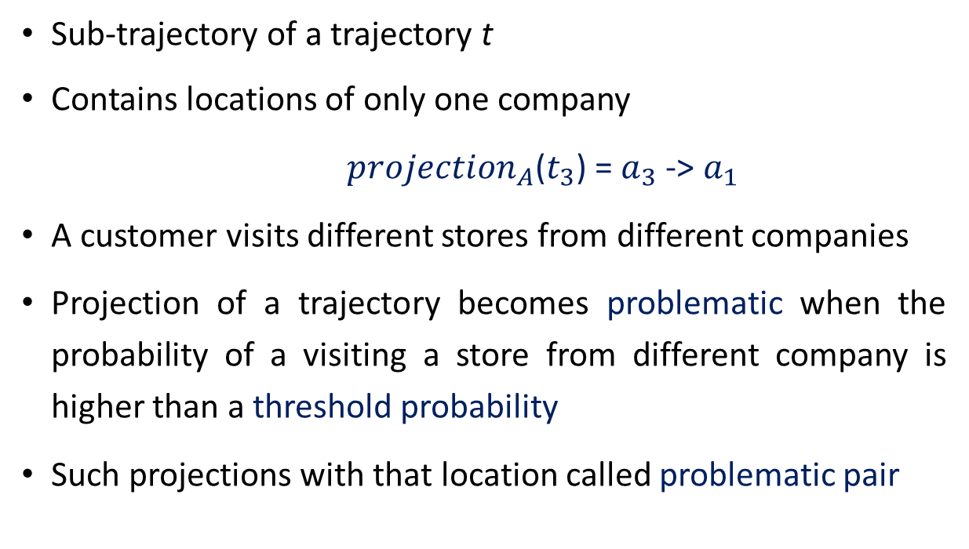
Preliminaries: Projection of a Trajectory
Sub-trajectory of a trajectory t
Contains locations of only one company
${projection}_{A}$($t_{3}$) = $a_{3}$-> $a_{1}$
A customer visits different stores from different companies
Projection of a trajectory becomes problematic when the probability of a visiting a store from different company is higher than a threshold probability
Such projections with that location called problematic pair
ID | Trajectory
t₁ | a₁→b₂→b₃
t₂ | b₁→a₁
t₃ | a₃→a₁→b₃
t₄ | b₂→b₁→a₂
t₅ | b₂→b₁→a₂
t₆ | b₂→b₁→a₁
t₇ | b₂→b₃→a₂

Slide 6

Formal Definition
Given a dataset T of trajectories, a user defined probability threshold and a set of adversaries, construct a safe (contains no problematic pair) dataset corresponding to T, with minimum information loss.

Slide 7

Existing Works
Terrovitis et. al [1] presented global suppression and splitting techniques
Suppressing a large projection with small projection (e.g, a3→a1 with a1)
Ensures anonymity gain and less information loss
Suppression occurs when it causes maximum utility gain
Assume two projections t_{R}^{A} and t_{r}^{A} where |t_{R}^{A}| > |t_{r}^{A}| and t_{r}^{A} is a subset of t_{R}^{A}
We want to suppress t_{R}^{A} with t_{r}^{A}

Slide 8




How Global Suppression Works?
1. Identify total number initial threats and problematic pairs
2. Find two projections t_{R}^{A} and t_{r}^{A} from the problematic pairs which gives maximum utility gain
3. Update dataset based on the unification of t_{R}^{A} with t_{r}^{A}
4. Recalculate total number of threats on updated dataset
5. Do step 2-4 unless total number of threats becomes zero

Slide 9

Limitations
Computes threats by scanning all trajectories
Updating dataset requires to do the threat identification
Finds unification pair by comparing all the projections

Slide 10

What we propose?
We propose an efficient data structure: Projection Support Tree (PST)
The global suppression algorithm becomes much faster while using PST
The data structure supports efficient update operation
The data structure provides correct solution in each iteration

Slide 11

How Global Suppression - PST Works?
1. Create Projection Support Tree (PST)
2. Identify total number initial threats and problematic pairs from (PST)
3. Find two projections t_{R}^{A} and t_{r}^{A} from the problematic pairs which gives maximum utility gain
4. Update PST based on the unification of t_{R}^{A} with t_{r}^{A}
5. Recalculate total number of threats on updated dataset
6. Do step 3-5 unless total number of threats becomes zero

Slide 12
Projection Support Tree - Creation
ID | Trajectory
t₁ | a₁→b₂→b₃
t₂ | b₁→a₁
t₃ | a₃→a₁→b₃
t₄ | b₂→b₁→a₂
t₅ | b₂→b₁→a₂
t₆ | b₂→b₁→a₁
t₇ | b₂→b₃→a₂
{Root}
P = 0.5
A
B
a₁
a₃→a₁
a₂
b₂→b₃
b₁
b₃
b₂→b₁
{t_{1,} t_{2,} t₆}
{t₃}
{t_{4,} t_{5,} t₇}
{t_{1,} t₇}
{t₂}
{t₃}
{t_{4,} t_{5,} t₆}
2
2
1
1
3
2
1
1
2
b₂
b₃
b₁
b₃
b₂
b₃
b₁
a₁
a₂
a₁
a₃
a₁
a₂
a₁
{t_{1,} t₆}
{t₁}
{t_{2,} t₆}
{t₃}
{t_{4,} t_{5,} t₇}
{t₇}
{t_{4,} t₅}
{t₁}
{t₇}
{t₂}
{t₃}
{t₃}
{t_{4,} t₅}
{t₆}
N = 15

Slide 13
{Root}
ID | Trajectory
t₁ | a₁→b₂→b₃
t₂ | b₁→a₁
t₃ | a₃→a₁→b₃
t₄ | b₂→b₁→a₂
t₅ | b₂→b₁→a₂
t₆ | b₂→b₁→a₁
t₇ | b₂→b₃→a₂
A
B
a₁
a₃→a₁
a₂
b₂→b₃
b₁
b₃
b₂→b₁
{t_{1,} t_{2,} t₆}
{t₃}
{t_{4,} t_{5,} t₇}
{t_{1,} t₇}
{t₂}
{t₃}
{t_{4,} t_{5,} t₆}
b₂
b₃
b₁
b₃
b₂
b₃
b₁
a₁
a₂
a₁
a₃
a₁
a₂
a₁
{t_{1,} t₆}
{t₁}
{t_{2,} t₆}
{t₃}
{t_{4,} t_{5,} t₇}
{t₇}
{t_{4,} t₅}
{t₁}
{t₇}
{t₂}
{t₃}
{t₃}
{t_{4,} t₅}
{t₆}

Slide 14
Projection Support Tree - Update
ID | Trajectory
t₁ | a₁→b₂→b₃
t₂ | b₁→a₁
t₃ | a₁→b₃
t₄ | b₂→b₁→a₂
t₅ | b₂→b₁→a₂
t₆ | b₂→b₁→a₁
t₇ | b₂→b₃→a₂
{Root}
a₃→a₁ with a₁
P = 0.5
A
B
a₁
a₃→a₁
a₂
b₂→b₃
b₁
b₃
b₂→b₁
{t_{1,} t_{2,} t₆}
{t₃}
{t_{1,} t_{2,} t_{3,} t₆}
{t_{4,} t_{5,} t₇}
{t_{1,} t₇}
{t₂}
{t₃}
{t_{4,} t_{5,} t₆}
2
2
1
1
3
2
1
1
2
b₂
b₃
b₁
b₃
b₂
b₃
b₁
a₁
a₂
a₁
a₃
a₁
a₂
a₁
{t_{1,} t₆}
{t_{1,} t₃}
{t_{4,} t₅}
{t₇}
{t₂}
{t₃}
{t₃}
{t_{4,} t₅}
{t₆}
{t₁}
{t_{2,} t₆}
{t₃}
{t_{4,} t_{5,} t₇}
{t₇}
{t₁}
N = 9

Slide 15
{Root}
ID | Trajectory
t₁ | a₁→b₂→b₃
t₂ | b₁→a₁
t₃ | a₁→b₃
t₄ | b₂→b₁→a₂
t₅ | b₂→b₁→a₂
t₆ | b₂→b₁→a₁
t₇ | b₂→b₃→a₂
a₃→a₁ with a₁
A
B
a₁
a₂
b₂→b₃
b₁
b₃
b₂→b₁
{t_{1,} t_{2,} t_{3,} t₆}
{t_{4,} t_{5,} t₇}
{t_{1,} t₇}
{t₂}
{t₃}
{t_{4,} t_{5,} t₆}
b₂
b₃
b₁
b₂
b₃
b₁
a₁
a₂
a₁
a₁
a₂
a₁
{t_{1,} t₆}
{t_{1,} t₃}
{t_{2,} t₆}
{t_{4,} t_{5,} t₇}
{t₇}
{t_{4,} t₅}
{t₁}
{t₇}
{t₂}
{t₃}
{t_{4,} t₅}
{t₆}

Slide 16

Experiments
Dataset: Real word-datasets introduced in [3] BMS-POS
Implementation: All algorithms are implemented in java
Machine: Intel Core i5 with 8 GB of RAM
Converted dataset into semantic trajectories from numeric values
Maximum number of adversary is 5
Number of distinct locations for each adversary is 100

Slide 17
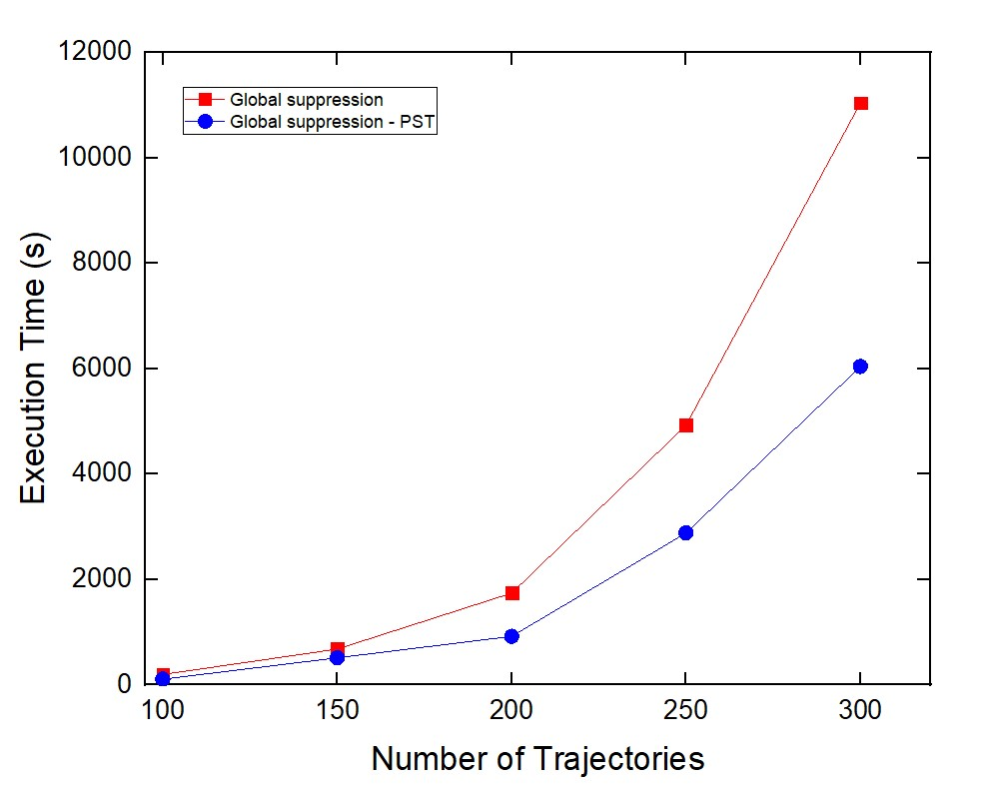
Algorithms Execution Time

Slide 18
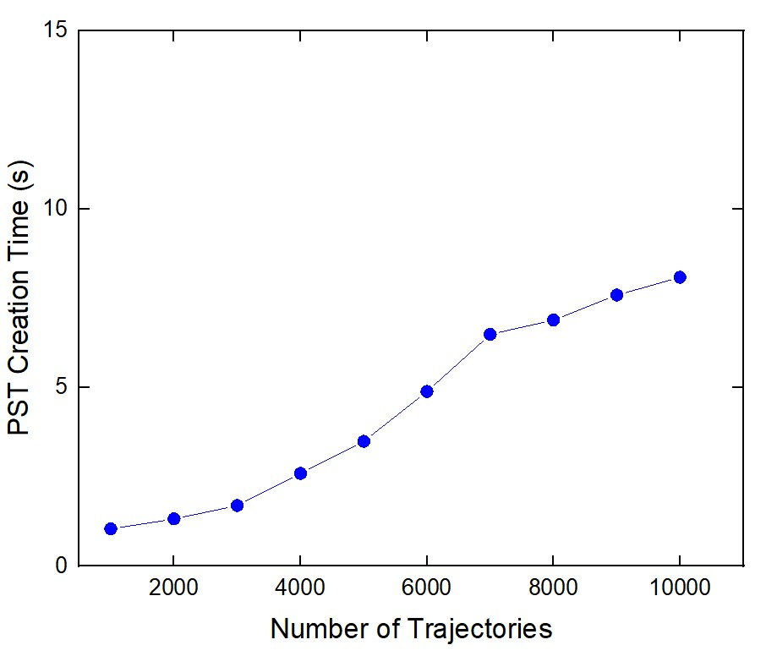
PST Creation Time

Slide 19
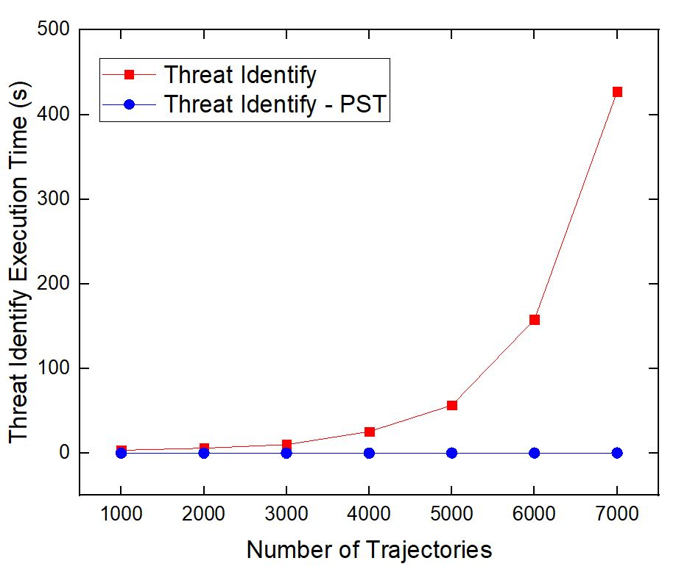
Threat Calculation Time

Slide 20
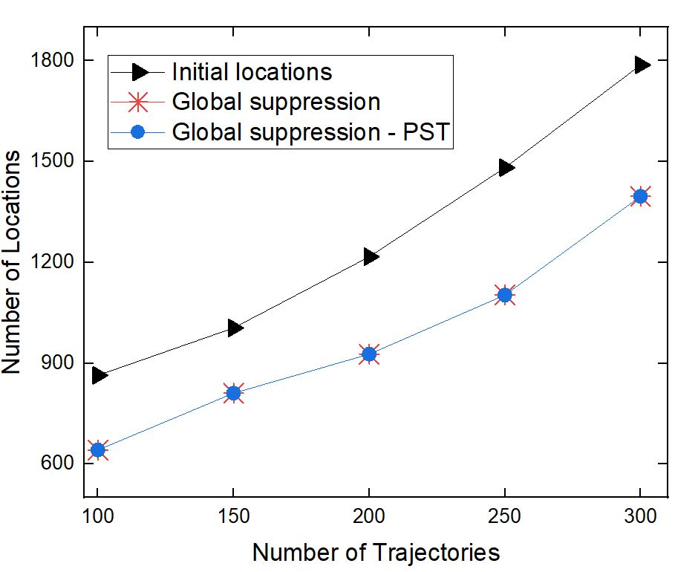
Locations after anonymization

Slide 21
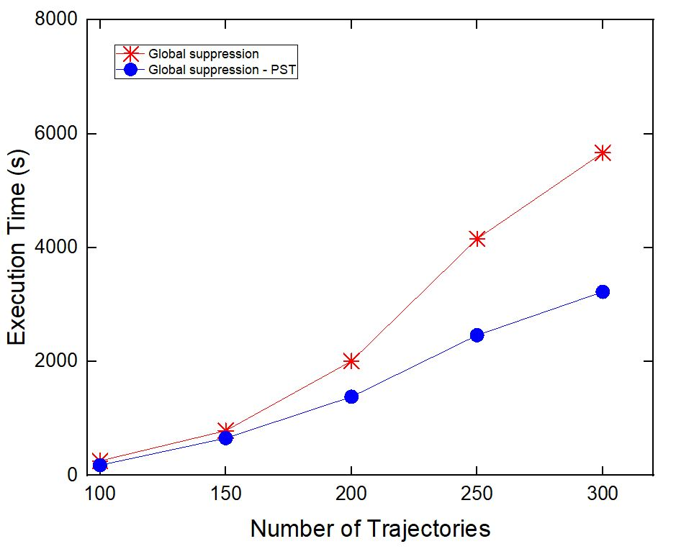
Random Dataset

Slide 22

Future Works
Implement local suppression using the proposed data structure
Explore splitting techniques based on the proposed data structure
Efficient utility gain calculation

Slide 23

Conclusion
Credit card transactional data stored in form of a trajectory
Publishing data while hiding identity can still breach individuals privacy
Global suppression technique increases anonymity with less information loss
PST data structure helps global supersession algorithm to compute faster anonymization
Experiment results shows that the above claim is correct

Slide 24

References
M. Terrovitis, G. Poulis, N. Mamoulis, and S. Skiadopoulos, “Local sup-pression and splitting techniques for privacy preserving publication oftrajectories,”IEEE Transactions on Knowledge and Data Engineering,vol. 29, no. 7, pp. 1466–1479, 2017.
C.-Y. Lin, Y.-C. Wang, W.-T. Fu, Y.-S. Chen, K.-C. Chien, and B.-Y.Lin, “Efficiently preserving privacy on large trajectory datasets,” in 2018IEEE Third International Conference on Data Science in Cyberspace(DSC), pp. 358–364, IEEE, 2018.
Z. Zheng, R. Kohavi, and L. Mason. “Real world performance of association rule algorithms.” In Proc. Of KDD, pages 401-406, 2001.

